Slide 1
CT4029 Principles of Programming Day 2 – Session 3 Code Reusability, Functions

Slide 2
Learning Outcomes
Code reusability through functions
Using built-in functions
Creating and using new functions
Passing arguments in functions

Slide 3
Today’s Agenda!
Functions
Built-In Functions
Type conversion (int, float)
Math functions (sin, sqrt)
Build Your Own Function
Arguments & Parameters

Slide 4
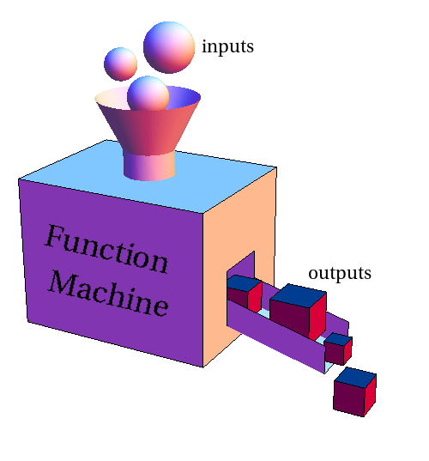
Functions

Slide 5
Functions
“A function is a unit of code that is often defined by its role within a greater code structure. Specifically, a function contains a unit of code that works on various inputs, many of which are variables, and produces concrete results involving changes to variable values or actual operations based on the inputs.” - Techopedia

Slide 6
Functions - Operation
If you have operations that are performed in various different parts of the program, then it makes sense to remove the repeated code and create a separate function or procedure that can be called from those places instead.
Not only will this reduce the size of your program, but it will make the code easier to maintain, and it will remove the possibility that some of the code segments are updated, but not others.
Functions eliminate the code repetition
Encourage code reusability

Slide 7
Stored (and reused) Steps
def
hello():
Program:
def thing():
print (“Hello”)
print (“Fun”)
thing()
Print(“Zip”)
thing()
print (“Hello”)
Output:
Hello
Fun
Zip
Hello
Fun
print (“Fun”)
hello()
print (“Zip”)
hello()
We call these reusable pieces of code “functions”

Slide 8
Python Functions
There are two kinds of functions in Python.
Built-in functions that are provided as part of Python - input(), type(), float(), int() ...
Functions that we define ourselves and then use
We treat the of the built-in function names as reserved words (i.e. we avoid them as variable names)

Slide 9
Built-in Functions

Slide 10
Function Definition (1/2)
In Python a function is some reusable code that takes arguments(s) as input does some computation and then returns a result or results
We define a function using the def reserved word
We call/invoke the function by using the function name, parenthesis and arguments in an expression

Slide 11
Function Definition (2/2)
Argument
big = max(“Hello world”)
Assignment
'w'
>>> big = max(“Hello world”)
>>> print (big)
>>> small = min(“Hello world”)
>>> print (small)>>>
Result

Slide 12
Max Function (1/2)
A function is some stored code that we use. A function takes some input and produces an output.
>>> big = max(“Hello world”)
>>> print (big)
max()
function
“Hello world”
(a string)
‘w’
(a string)

Slide 13
Max Function (2/2)
A function is some stored code that we use. A function takes some input and produces an output.
>>> big = max(“Hello world”)
>>> print (big)
def max(inp):
blah
blah
for x in y:
blah
blah
“Hello world”
(a string)
‘w’
(a string)

Slide 14
Type Conversions
>>> print (float(99) / 100)
0.99
>>> i = 42
>>> type(i)
<type 'int'>
>>> f = float(i)
>>> print (f)
42.0
>>> type(f)
<type 'float'>
>>> print (1 + 2 * float(3) / 4 – 5)
-2.5
When you put an integer and floating point in an expression the integer is implicitly converted to a float
You can control this with the built in functions int() and float()

Slide 15
String Conversions
>>> sval = '123'
>>> type(sval)
<type 'str'>
>>> print (sval + 1)
Traceback (most recent call last):
File "<stdin>", line 1, in <module>
TypeError: cannot concatenate 'str' and 'int'
>>> ival = int(sval)
>>> type(ival)
<type 'int'>
>>> print (ival + 1)
124
>>> nsv = 'hello bob'
>>> niv = int(nsv)
Traceback (most recent call last):
File "<stdin>", line 1, in <module>
ValueError: invalid literal for int()
You can also use int() and float() to convert between strings and integers
You will get an error if the string does not contain numeric characters

Slide 16
Functions - Operation
>>> num1 = 4
>>> num2 = 6
>>> total = num1 + num2
>>> print (total)
num1 = 4
num2 = 6
def add():
sum = num1 + num2
print (sum)
add()
add()
Output:
10
Output:
10

Slide 17
Functions - Operation
>>> num1 = 4
>>> num2 = 6
>>> total = num1 + num2
>>> print (total)
>>> num1 = 5
>>> num2 = 10
>>> total = num1 + num2
>>> print (total)
num1 = 4
num2 = 6
def add():
sum = num1 + num2
print (sum)
add()
num1 = 5
num2 = 10
add()
add()
Output:
15
Output:
15

Slide 18

Build Your Own Functions

Slide 19
Building our Own Functions
We create a new function using the def keyword followed by optional parameters in parenthesis.
We indent the body of the function
This defines the function but does not execute the body of the function
def print_lyrics():
print ("I'm a lumberjack, and I'm okay.”)
print (“I sleep all night and I work all day.”)

Slide 20
Example
x = 5
print (“Hello”)
def print_lyrics():
print ("I'm a lumberjack, and I’m okay.”)
print (“I sleep all night and I work all day.”)
print (“Yo”)
x = x + 2
print (x)
Output:
Hello
Yo
7

Slide 21
Definitions and Uses
Once we have defined a function, we can call (or invoke) it as many times as we like
This is the store and reuse pattern

Slide 22
Example
x = 5
print (“Hello”)
def print_lyrics():
print ("I'm a lumberjack, and I’m okay.”)
print (“I sleep all night and I work all day.”)
print (“Yo”)
x = x + 2
print (x)
print_lyrics()
Output:
Hello
Yo
7
I'm a lumberjack, and I'm okay.
I sleep all night and I work all day.

Slide 23
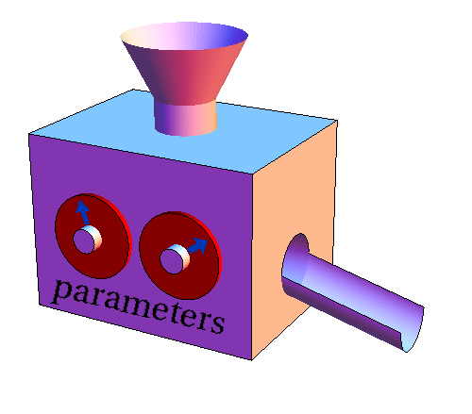
Arguments and Parameters

Slide 24
Arguments
An argument is a value we pass into the function as its input when we call the function
We use arguments so we can direct the function to do different kinds of work when we call it at different times
We put the arguments in parenthesis after the name of the function
big = max(“Hello world”)
Argument

Slide 25
Parameters
>>> def greet(lang):
if lang == 'es’:
print (“Hola”)
elif lang == ‘fr’:
print (“Bonjour”)
else:
print (“Hello”)
>>> greet('en’)
Hello
>>> greet('es’)
Hola
>>> greet('fr’)
Bonjour
A parameter is a variable which we use in the function definition that is a “handle” that allows the code in the function to access the arguments for a particular function invocation.

Slide 26
Return Values
Often a function will take its arguments, do some computation and return a value to be used as the value of the function call in the calling expression. The return keyword is used for this.
Output:
def greet():
return "Hello”
print (greet(), ”Sam”)
print (greet(), ”Becky”)
Hello Sam
Hello Becky

Slide 27
Return Value
>>> def greet(lang):
if lang == 'es’:
return 'Hola’
elif lang == 'fr’:
return 'Bonjour’
else:
return 'Hello’
>>> print (greet('en’),”Glenn”)
Hello Glenn
>>> print (greet('es’),”Sally”)
Hola Sally
>>> print (greet('fr’),”Michael”)
Bonjour Michael
A “fruitful” function is one that produces a result (or return value)
The return statement ends the function execution and “sends back” the result of the function

Slide 28
Arguments, Parameters, and Results
>>> big = max(“Hello world”)
>>> print (big)
Parameter
def max(inp):
blah
blah
for x in y:
blah
blah
return ‘w’
“Hello world”
‘w’
Argument
Result

Slide 29
Multiple Parameters / Arguments
We can define more than one parameter in the function definition
We simply add more arguments when we call the function
We match the number and order of arguments and parameters
def addtwo(a, b):
added = a + b
return added
x = addtwo(3, 5)
print (x)
Output:
8

Slide 30
Void (non-fruitful) Functions
When a function does not return a value, we call it a "void" function
Functions that return values are "fruitful" functions
Void functions are "not fruitful"

Slide 31
To function or not to function...
Organize your code into “paragraphs” - capture a complete thought and “name it”
Don’t repeat yourself - make it work once and then reuse it
If something gets too long or complex, break up logical chunks and put those chunks in functions
Make a library of common stuff that you do over and over - perhaps share this with your friends...

Slide 32
Next Session!
Basics of Graphical User Interface in Python
We will be focusing on Tkinter

